Slide 1



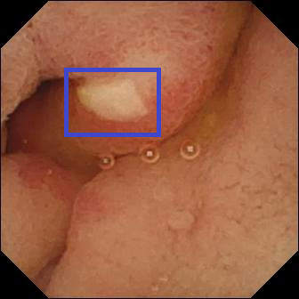
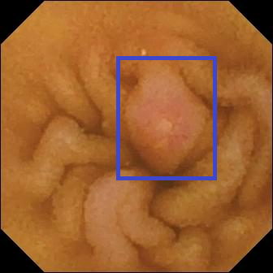
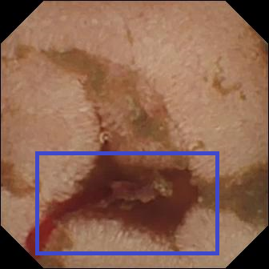

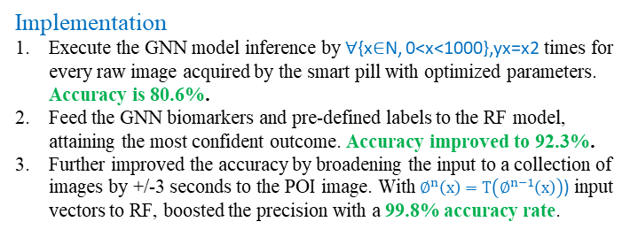
Colorectal Cancer Diagnosis: Achieving consistent accuracy in medical imagery analysis from a swallowable smart pill; a comparative study between Deep Learning and Random Forest models
Sarvesh Prabhu, Lambert High School | Mentor: Bob Foreman, LexisNexis Risk Solutions
Goals
Achieve the highest consistent accuracy in diagnosing colorectal cancer using medical imagery analysis utilizing HPCC GNN & ECL-ML libraries.
Discovery of biomarkers (features) of 1m images of upper & lower GI tract using GNN bundle.
Perform GI diagnosis in two ways in ECL: Deep Learning using the convolutional neural network & TensorFlow and Random Forest model using the learning trees bundle.
Compare the model outcomes, hypertuning, and ensembling.
Conclude the research and publish results for the Healthcare and HPCC community.
Generalized Neural Network Model
HPCC GNN imagery analysis model uses image features through layers of kernel convolutions to detect anomalies and aspects of interest. It is then passed through binary cross-entropy.
Diagnosis: Ulcer
Erosion
Digestive tract bleeding
Implementation
Execute the GNN model inference by ∀{x∈N, 0<x<1000},yx=x2 times for every raw image acquired by the smart pill with optimized parameters. Accuracy is 80.6%.
Feed the GNN biomarkers and pre-defined labels to the RF model, attaining the most confident outcome. Accuracy improved to 92.3%.
Further improved the accuracy by broadening the input to a collection of images by +/-3 seconds to the POI image. With $∅^{n}\left(x\right)=T\left(∅^{n−1}\left(x\right)\right)$) input vectors to RF, boosted the precision with a 99.8% accuracy rate.
Kernel Convolution is measured by
(K∗ I)(i, j) = ∑_{m} ∑_{n} (I − m, j − n)K(m,n)
Random Forest-Tree Model
The random forest takes many decision trees to train itself in a “forest” pattern. For this research, the classification was based upon anomalies numerically, using number codes to identify and detect a cancerous biomarker through classification.
Research Overview
The advancement of ML in the medical field, particularly cancer diagnosis, has long been held back based on accuracy limitations and a lack of trust from the practitioners. Since the diagnosis changes the course of action taken on a patient, any false +ve or -ve leads to potentially unnecessary treatment or even a loss of life. As a result, ML has not played the role of a primary predictor, acting as an optional aid.
My research aims to perform GI diagnosis by accurately highlighting the biomarkers (polyp, ulcer, etc.) from the pictures captured by a swallowable smart pill as it travels through the GI tract.
The research empowers Physicians to reach a faster conclusion for patient treatment by several hours in advance compared to a traditional colonoscopy, all while being non-invasive.
Conclusion
The research concludes that ensembling the GNN and multi-layered Random Forest yields the highest accuracy and consistent results with 99.8% precision, enabling the practitioner to make an informed treatment decision for the patient in need of urgent care.
Random Forest Classification is measured by
Gini = 1 - Σ^{c}_{i=1} (P_{i})²
GNN Specs
Training to Testing ratio is 78:22
Tensor dimension [3 x 60 x 60]
Optimizer: Adams
Loss: Binary Cross entropy
Random Forest Specs
Trees 24, Variables 2
Max depth: 255
Forest size: 10
Gini: 0.326-0.498
Resources
OSF | The Kvasir-Capsule Dataset
The coming of AI Spring
Code & Credits
Github.com/SarveshPrabhu90
Github.com/RogerDev/GNN
Thanks to Bob Foreman, Roger Dev, and Lorraine Chapman.

